Slide 1
Zapier Lead Reassignment Analysis
Decision story on lead volume, reassignment-flow task consumption, and where automation should be controlled.
Notes:
Open the presentation by framing the goal: this is not only a reporting exercise. The objective is to decide where Zapier reassignment automation is valuable and where repeated reassignment becomes low-return task consumption.

Slide 2
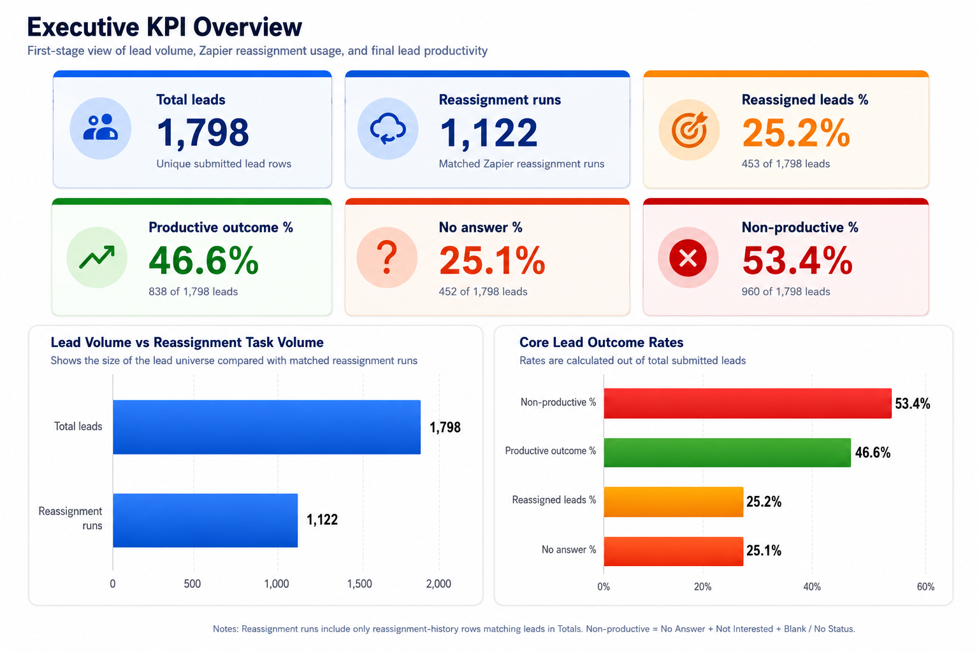
Notes:
Slide 1 — Executive KPI Overview
Main message: the company has both a reassignment-cost problem and a lead-productivity problem.
Talk track: We have 1,798 total leads, 453 reassigned leads, and 1,122 matched reassignment runs. Reassignment is therefore a meaningful Zapier task consumer. Outcomes are mixed: 46.6% are productive while 53.4% are non-productive. The question is whether repeated reassignment creates enough value to justify the task consumption.
Transition: To understand the root cause, start with where lead volume comes from.

Slide 3
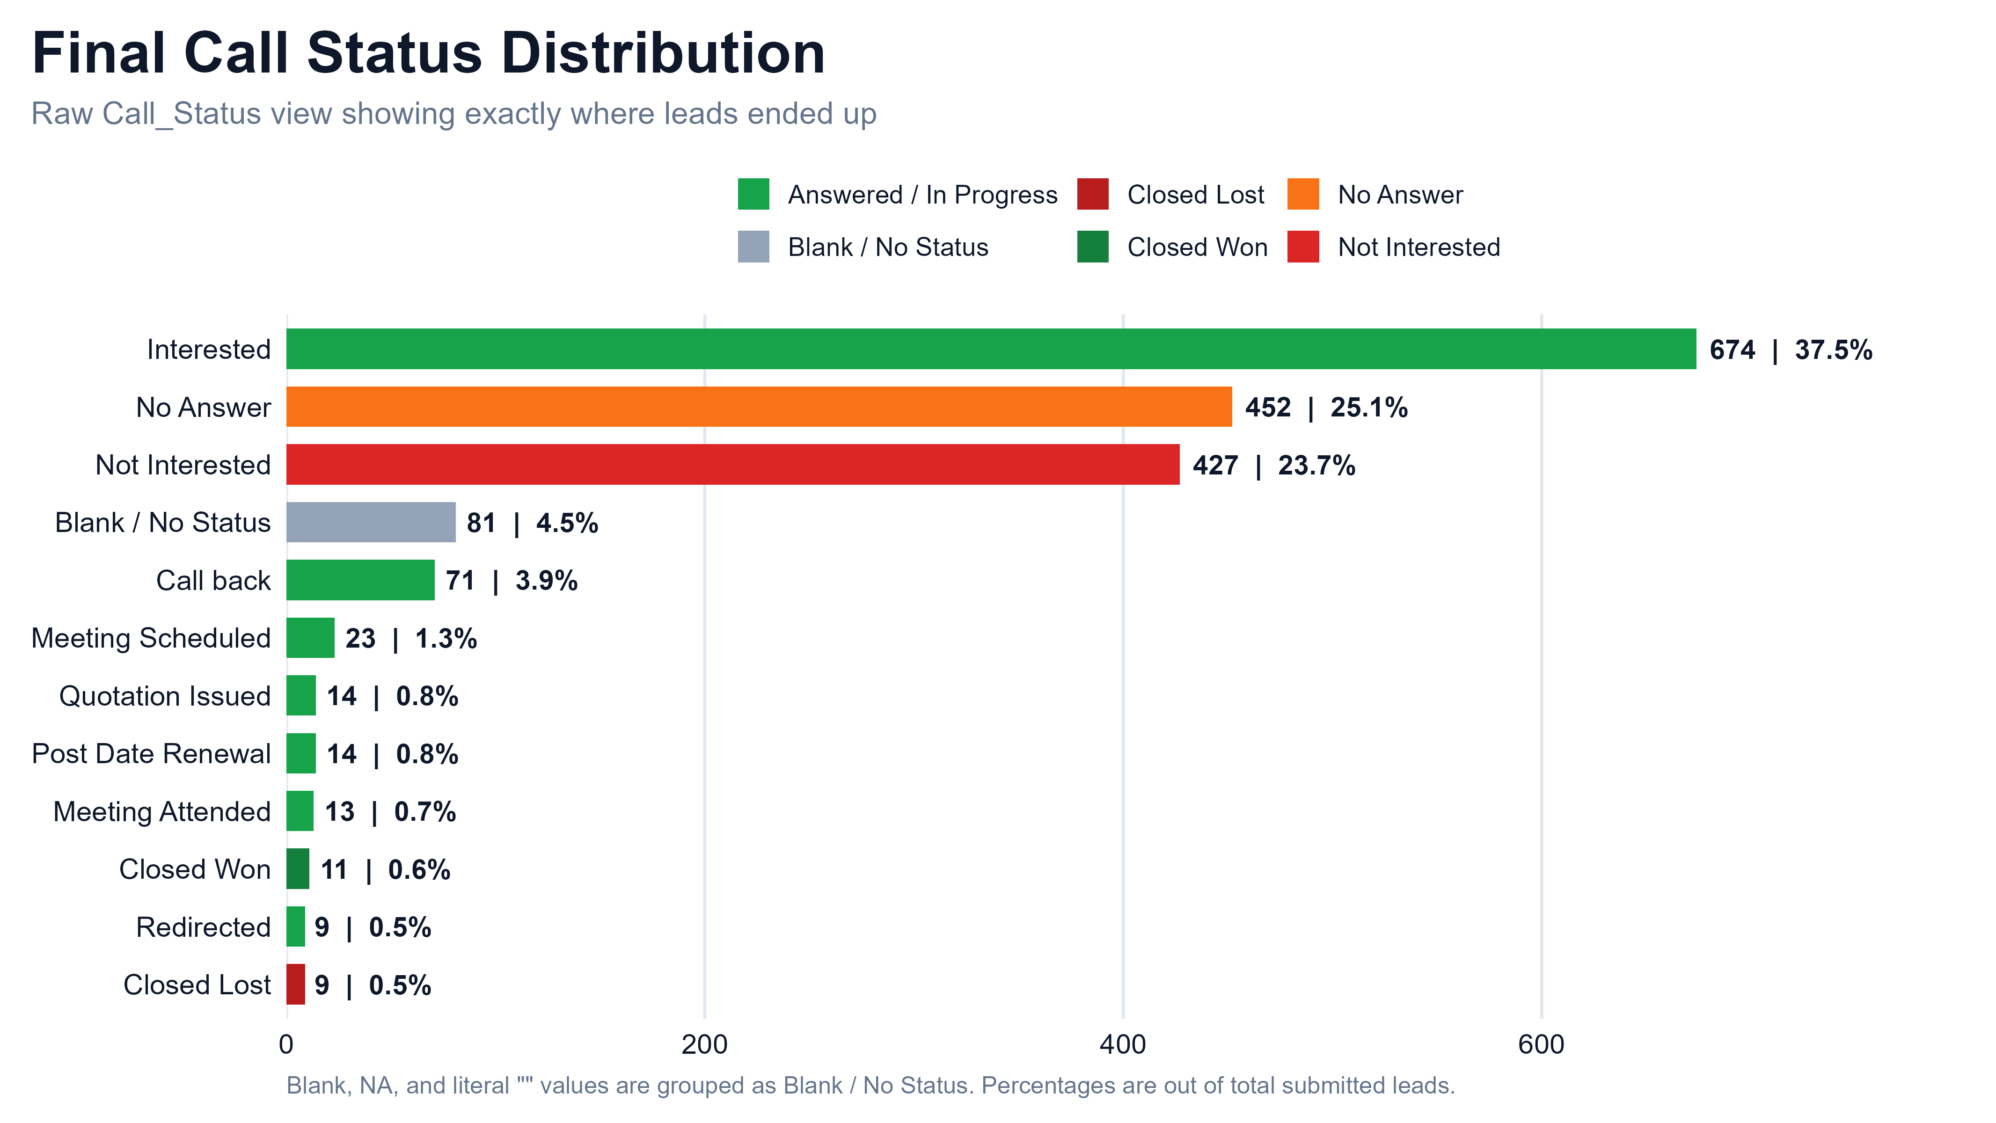
Notes:
Slide 1 — Executive KPI Overview
Main message: the company has both a reassignment-cost problem and a lead-productivity problem.
Talk track: We have 1,798 total leads, 453 reassigned leads, and 1,122 matched reassignment runs. Reassignment is therefore a meaningful Zapier task consumer. Outcomes are mixed: 46.6% are productive while 53.4% are non-productive. The question is whether repeated reassignment creates enough value to justify the task consumption.
Transition: To understand the root cause, start with where lead volume comes from.

Slide 4
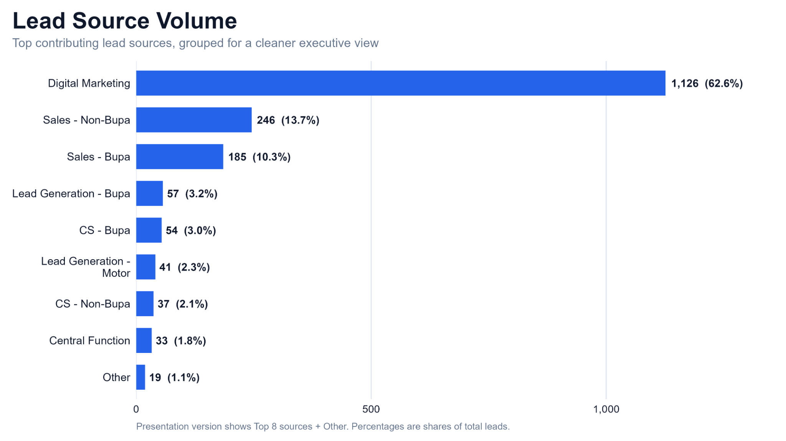
Notes:
Slide 2 — Lead Source Volume
Main message: Digital Marketing dominates lead volume.
Talk track: Digital Marketing contributes 1,126 leads, 62.6% of all leads. Sales - Non-Bupa and Sales - Bupa are the next largest sources, but far smaller. This means any quality or reassignment issue inside Digital Marketing will strongly affect the full business picture.
Transition: After source volume, we need to see which sales teams receive the highest load.

Slide 5
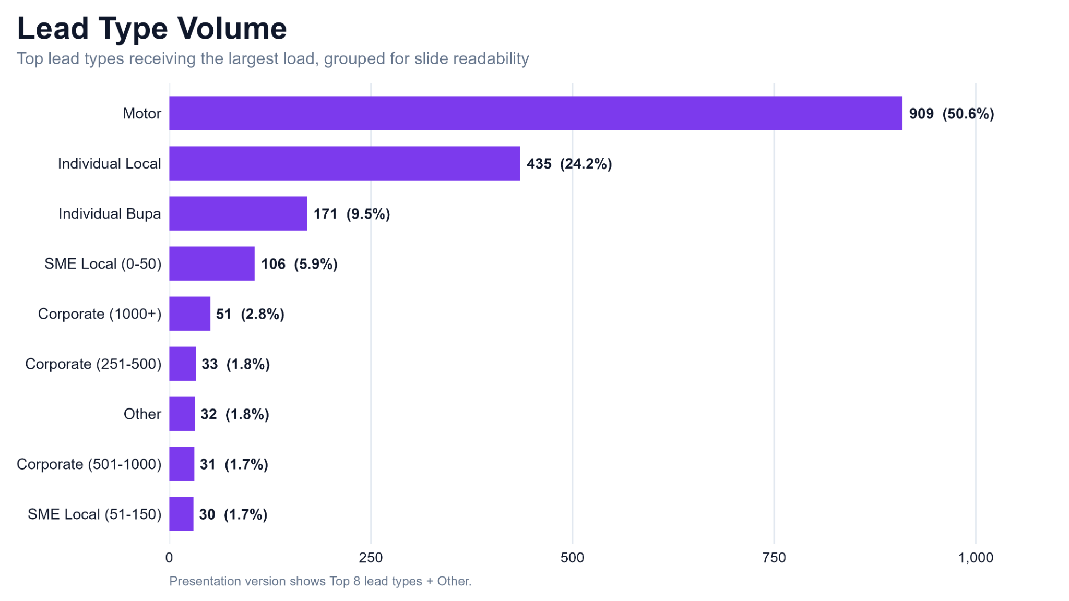
Notes:
Slide 3 — Lead Type Volume
Main message: Motor and Individual Local dominate team workload.
Talk track: Motor receives 909 leads, 50.6% of all leads. Individual Local receives 435 leads, 24.2%. Together they represent nearly 75% of lead load. If these lead types have operational issues, they will have the biggest process impact.
Transition: Before diagnosing reassignment, first look at the final outcomes of all leads.

Slide 6
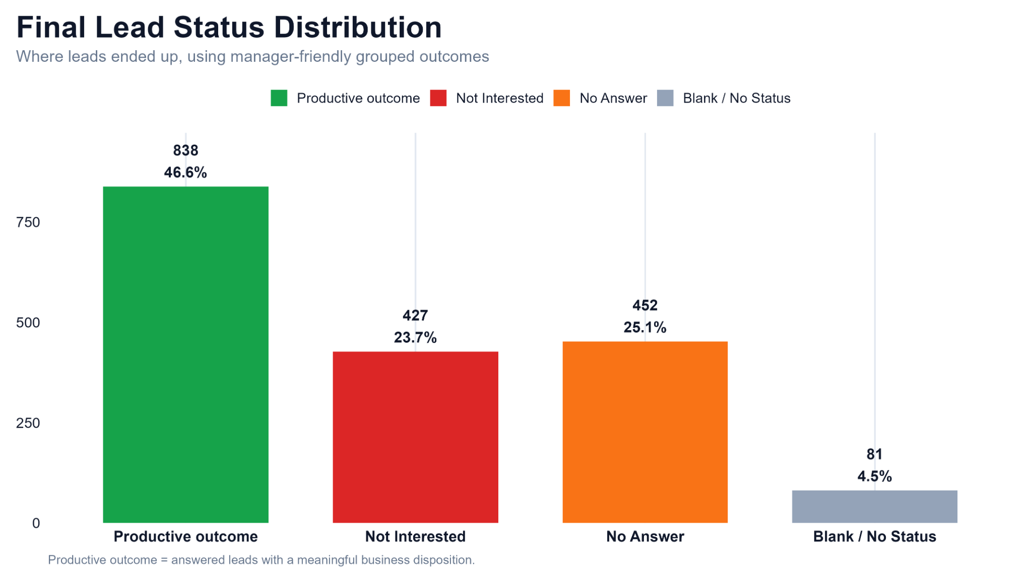
Notes:
Slide 4 — Final Lead Status Distribution
Main message: the non-productive side is larger than the productive side.
Talk track: Productive outcomes are 838 leads, 46.6%. No Answer is 452 leads, 25.1%. Not Interested is 427 leads, 23.7%. Blank/no status is 81 leads, 4.5%. Combined, No Answer + Not Interested + Blank/No Status equals 53.4% non-productive. This means reassignment should be judged by whether it improves outcomes, not only by how many runs it creates.
Transition: Now move from outcomes to Zapier task cost by lead type.

Slide 7
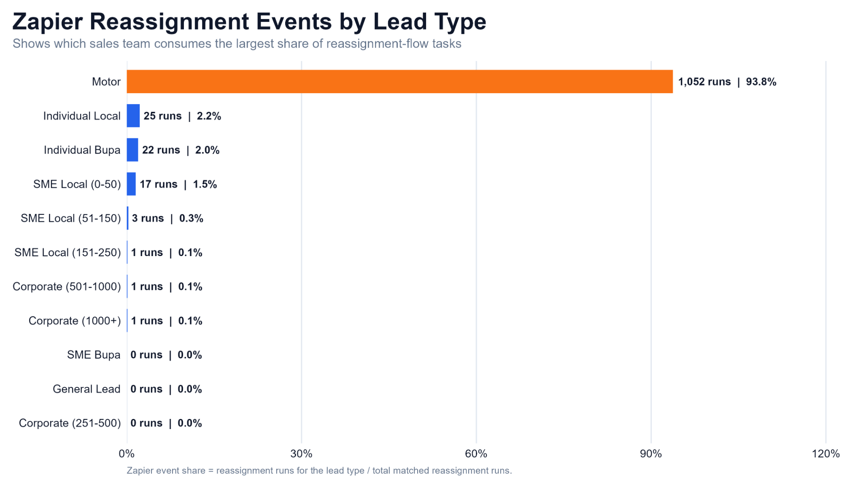
Notes:
Slide 5 — Zapier Reassignment Events by Lead Type
Main message: Motor is the main reassignment-task consumer.
Talk track: Motor consumes 1,052 reassignment runs, equal to 93.8% of all matched reassignment events. This is disproportionate compared with its 50.6% share of total leads. Individual Local, the second-largest lead type, consumes only 25 runs or 2.2%. Therefore, if the goal is to reduce Zapier task consumption, Motor is the first investigation area.
Transition: Next, check whether Motor consumes more tasks only due to volume, or because Motor leads are more likely to be reassigned.

Slide 8
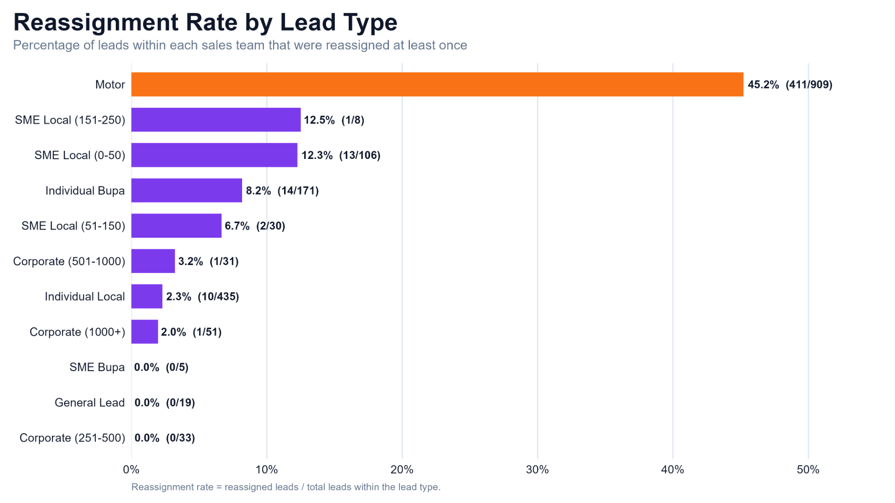
Notes:
Slide 6 — Reassignment Rate by Lead Type
Main message: Motor has both high volume and a high reassignment rate.
Talk track: 45.2% of Motor leads were reassigned at least once: 411 out of 909. This is much higher than other major lead types. Individual Local has only 2.3% despite high volume. So Motor has a double impact: the highest lead volume and the highest reassignment rate.
Transition: Now we need to see whether the repeated reassignment cases are also concentrated in Motor.

Slide 9
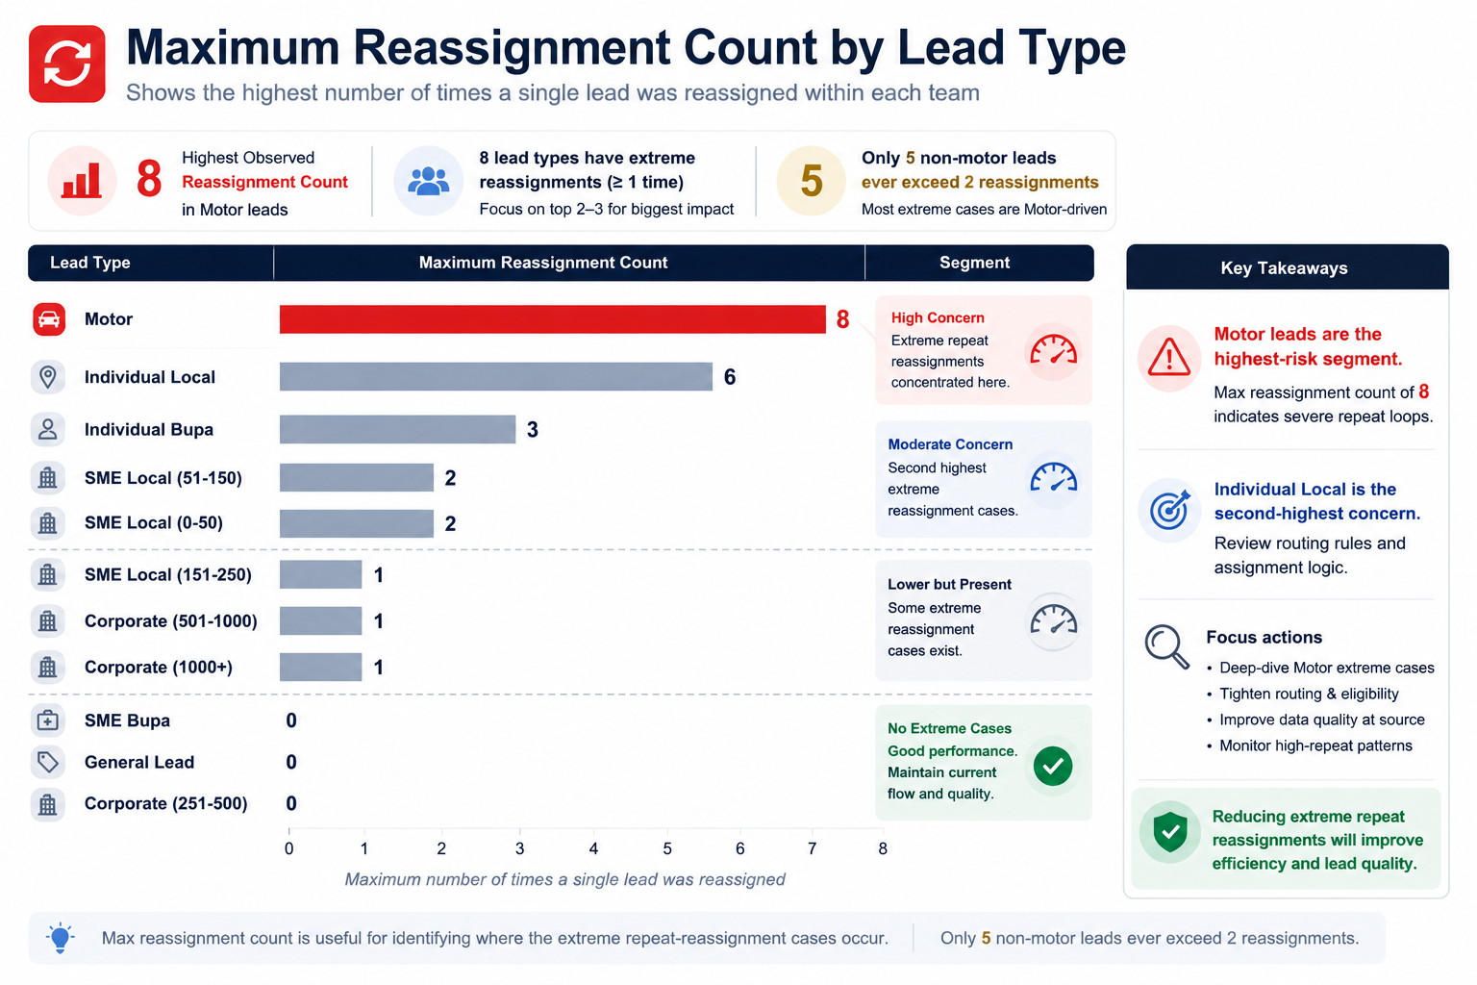
Notes:
Slide 7 — Maximum Reassignment Count by Lead Type
Main message: extreme repeat loops are mostly Motor-driven.
Talk track: The highest observed reassignment count is 8, in Motor leads. Individual Local reaches 6, and Individual Bupa reaches 3. The key additional insight is that only 5 non-Motor leads ever exceed 2 reassignments. This means extreme repeat reassignment is concentrated in Motor, and Motor should have a specific reassignment rule rather than a generic process applied equally to all teams.
Transition: Next, evaluate whether repeated reassignment improves outcomes or whether the lead remains unanswered.

Slide 10
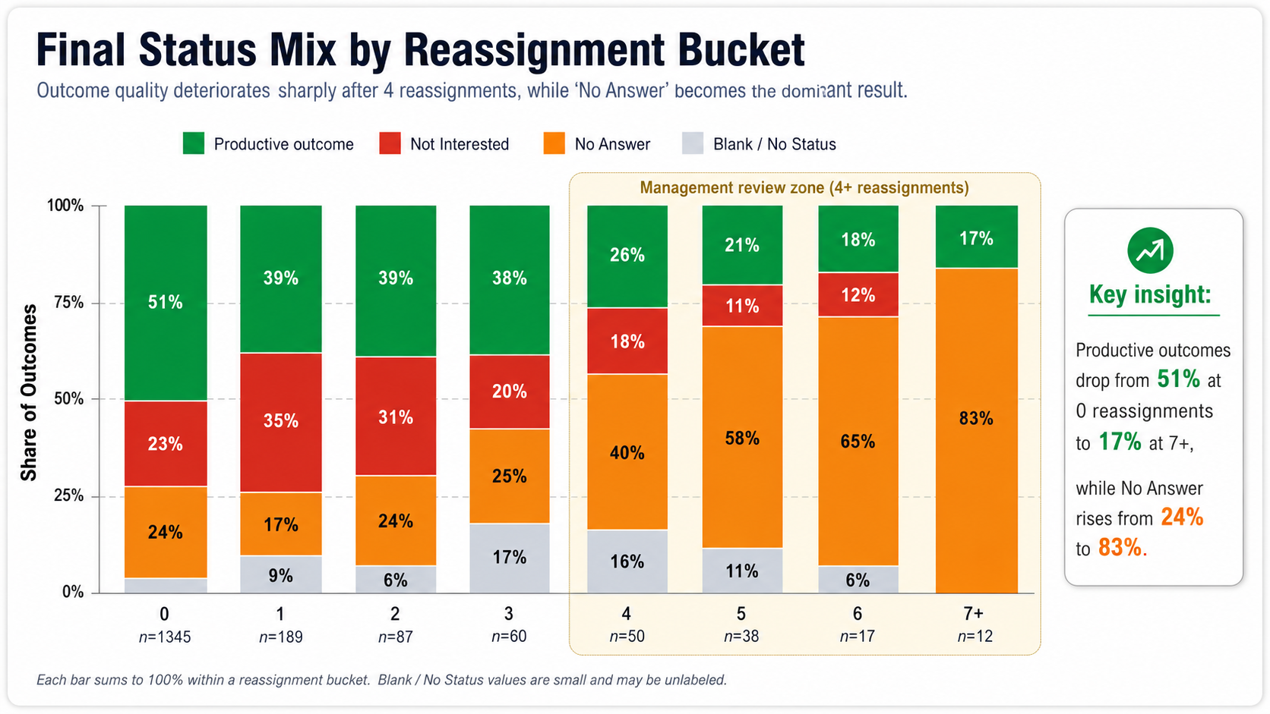
Notes:
Slide 8 — Final Status Mix by Reassignment Bucket
Main message: outcome quality deteriorates after repeated reassignment.
Talk track: At 0 reassignments, productive outcome is 51% and No Answer is 24%. By 4 reassignments, productive outcome drops to 26% and No Answer rises to 40%. At 5 reassignments No Answer is 58%, at 6 it is 65%, and at 7+ it is 83%. This makes the 4+ reassignment zone a management review threshold.
Transition: The next slide isolates only No Answer to make the threshold clearer.

Slide 11
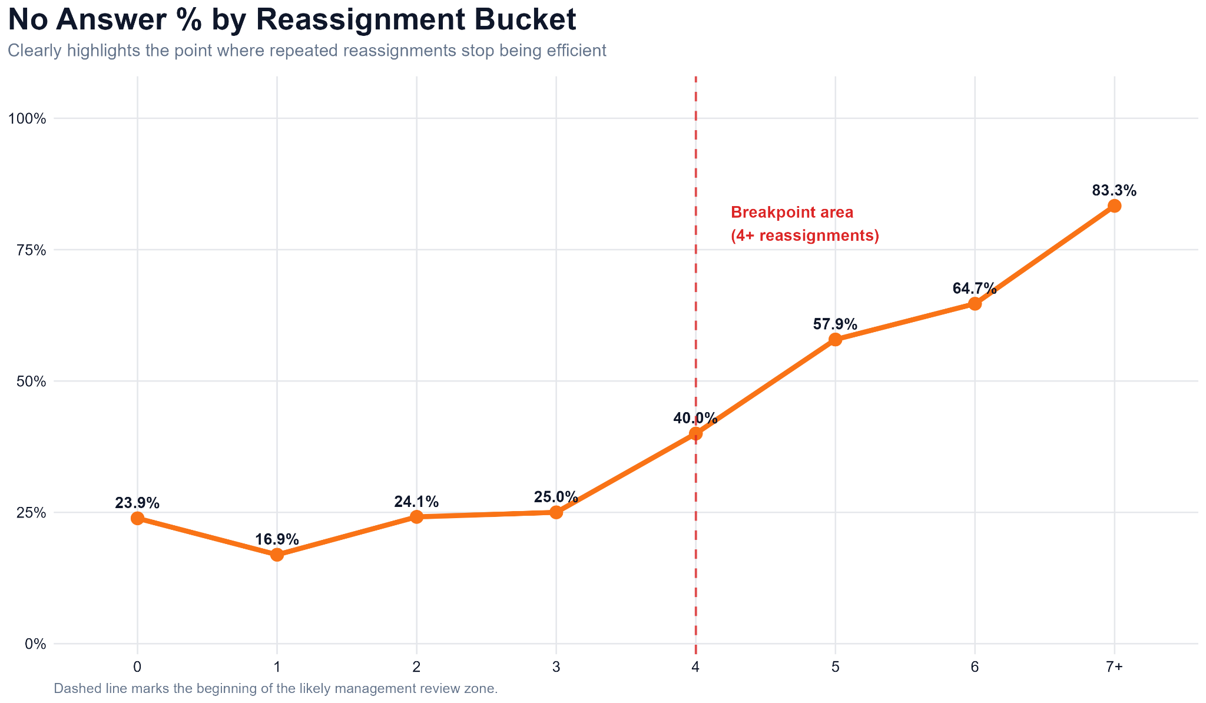
Notes:
Slide 9 — No Answer % by Reassignment Bucket
Main message: No Answer accelerates sharply after 4 reassignments.
Talk track: From 0 to 3 reassignments, No Answer stays around 17% to 25%. At 4 reassignments it jumps to 40%, then rises to 57.9%, 64.7%, and finally 83.3% at 7+. This is the clearest evidence that repeated reassignment becomes low-return after a threshold.
Transition: Finally, connect reassignment cost back to lead source quality.

Slide 12
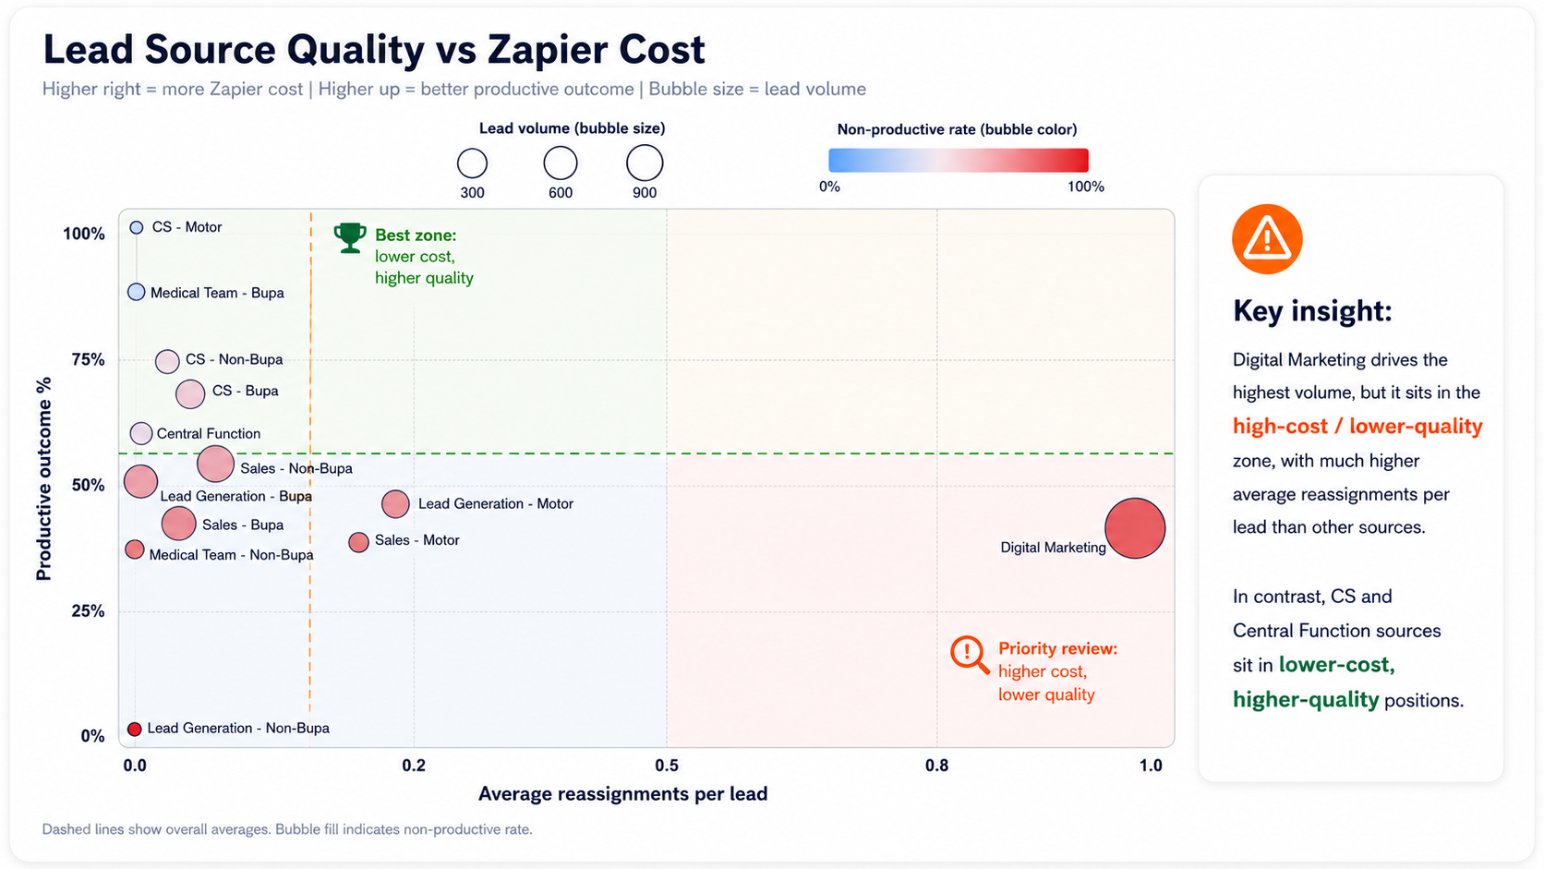
Notes:
Slide 10 — Lead Source Quality vs Zapier Cost
Main message: Digital Marketing is the source-level priority.
Talk track: This bubble chart combines volume, productive outcome rate, and reassignment cost. Digital Marketing has the largest volume, sits far right with much higher average reassignments per lead, and is below the productive outcome average. That places it in the high-cost/lower-quality zone. Because Digital Marketing drives most volume, even small improvements in validation, routing, and follow-up rules can reduce a large amount of Zapier task consumption.
Transition: Close with concrete decision rules.

Slide 13
Recommended Decisions
Control repeated reassignment — do not stop useful early reassignment.
Reassignment policy
Recommended action
0–3 reassignments
Continue normal automated reassignment
Introduce a 4+ reassignment control point, with Motor-specific rules and Digital Marketing validation improvements.
4 reassignments
Trigger management review zone
5–6 reassignments
Move to alternative handling / stop normal auto-reassignment
7+ reassignments
No further automatic reassignment unless manually approved
Expected benefit
Reduce low-return Zapier task consumption while preserving useful early reassignment attempts.
Priority focus areas
Motor
93.8% of reassignment events; max 8 reassignments
Review Motor reassignment logic first
Digital Marketing
62.6% of leads; high cost/lower quality
Improve validation, routing, and follow-up rules
Individual Local
High volume and high No Answer, but low reassignment cost
Improve contactability and call strategy
Individual Bupa
Weak productive outcome rate
Review quality and qualification
Closing statement: Keep early reassignment, but prevent indefinite repeat loops.
Notes:
Use this slide to move from insight to action. The recommendation is not to stop reassignment completely. The data supports keeping useful early reassignment but adding a clear 4+ reassignment control point to reduce low-return Zapier task consumption, especially for Motor and Digital Marketing-driven leads.

